Slide 1

AIDL Club:
Workshop on
Supervised Machine Learning
Dr. Shubhangi Vaikole
Professor & HoD
Department of Information Technology
FCRIT,Vashi

Slide 2
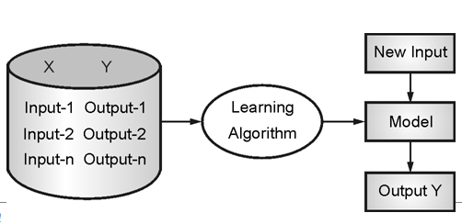
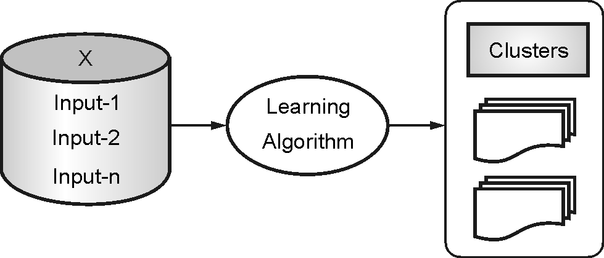
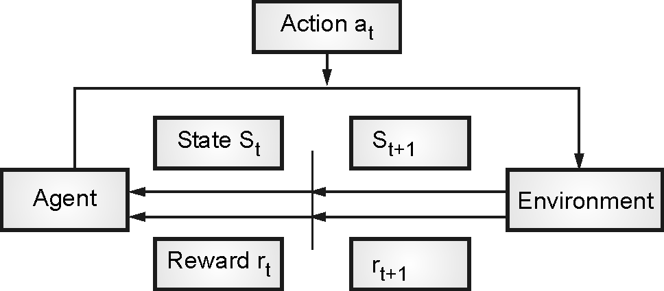
Types of Machine Learning
Supervised Learning
Unsupervised Learning
Reinforcement learning

Slide 3
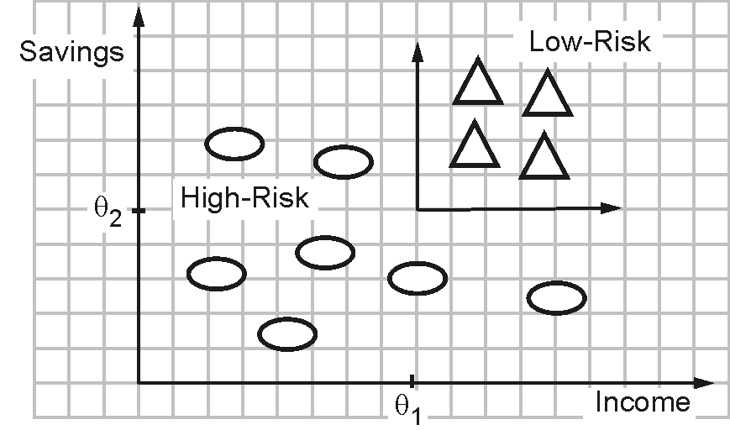
Regression
Y: price of flat
Y=w*x + w₀
X: area of flat
Classification

Slide 4

Regression

Slide 5

Learning with Regression
Linear Regression
Logistic Regression

Slide 6
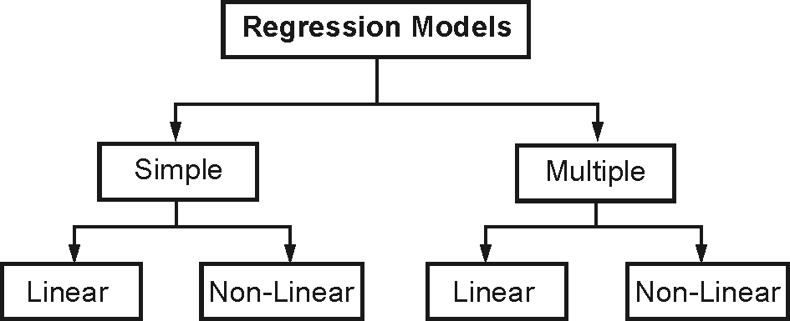
Learning with Regression

Slide 7
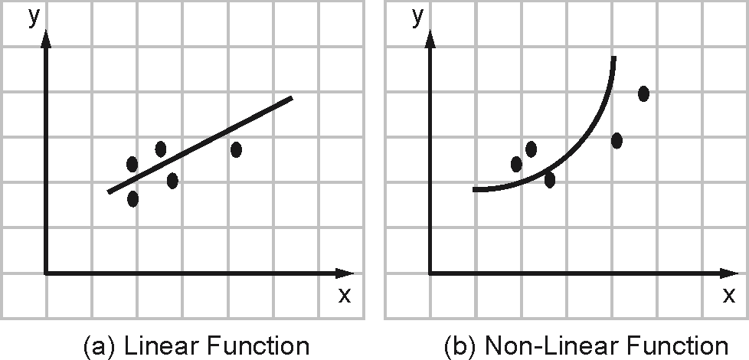
Simple Linear Regression
Y is called as criterion variable and X is called as predictor variable.
X contains a single feature.
X contains more than one feature

Slide 8
Calculation of Regression Parameters
Sr.No. | X | Y | XY | X²
1 | 2 | 2 | 4 | 4
2 | 4 | 4 | 16 | 16
3 | 6 | 3 | 18 | 36
4 | 8 | 6 | 48 | 64
Total | 20 | 15 | 86 | 120
The regression line equation is,
Y' = a X + b
a =
Now the equation for the line becomes,
Y' = 0.55 X + 2.2
For X = 2,
Y' = (0.55) (2) + 1 = 2.2
For X = 4,
Y' = (0.55) (4) + 1 = 3.2
For X = 6,
Y' = (0.55) (6) + 1 = 4.3
For X = 8,
Y' = (0.55) (8) + 1 = 5.4
=0.55
b=
=1

Slide 9
Multiple Linear Regression
In Multiple linear regressions there is two or more number of features. We can also say it is a extension to simple linear regression.
The regression line is represented using the following equation,
Y' = a₀ + a₁ X₁ + a₂ X₂ +----------+ a_{n} X_{n} + e
In the above equation Y’ is the predicted value, X₁ X₂ ₋₋₋₋₋₋₋ X_{n} are the predictors , e is random error and a₀ a_{1…..} a_{n} are regression coefficients.

Slide 10
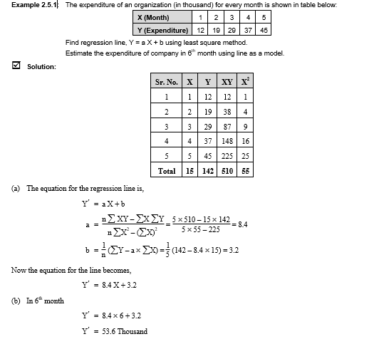
Linear Regression

Slide 11
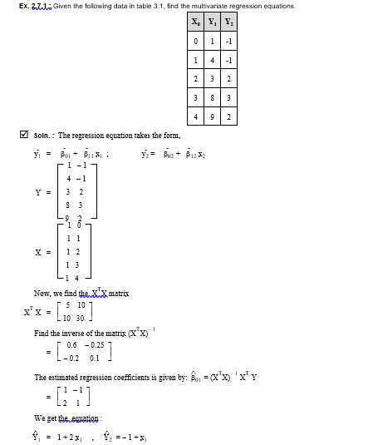
Multivariate Linear Regression

Slide 12
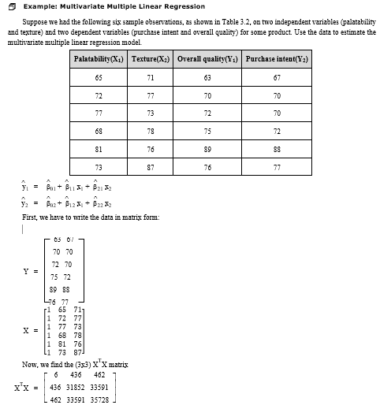
Multivariate Multiple Linear Regression

Slide 13
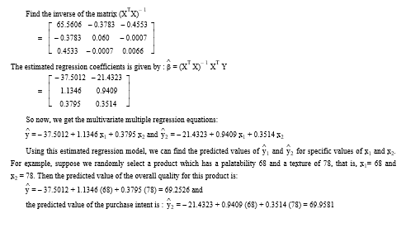

Slide 14
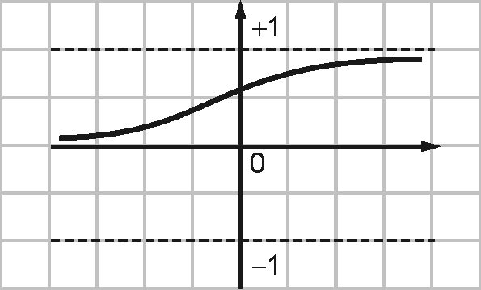
LOGISTIC REGRESSION
The net input to the sigmoid function is,
Z = b0 + b1 x1 + b2 x2 +------------- + bn xn
Output = 1/(1+exp(-z))
Finally the data points are classified as,
Class = 1 if output > =0.5
= 0 else

Slide 15
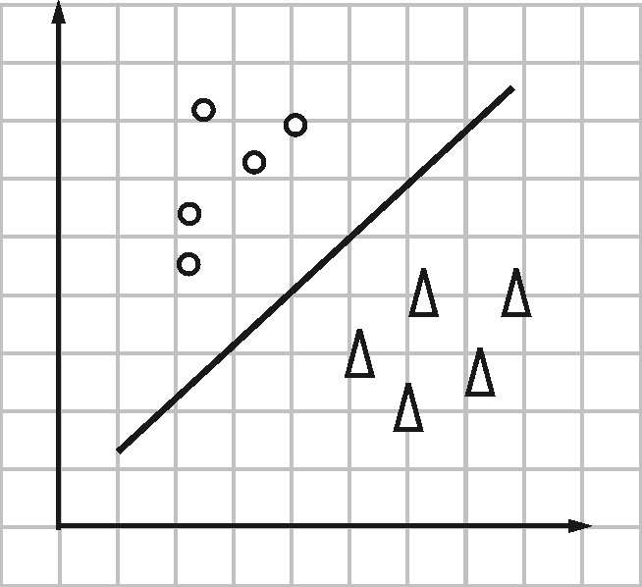
Sample of output of Logistic regression

Slide 16
Types of Logistic Regression
Binary Logistic Regression
Binary logistic regression is used if the target variable is binary.
The application of this method can be above mentioned house management example.
Nominal Logistic Regression
Nominal Logistic Regression is used if there are three or more classes without any specific orders.
The examples of this type of regression could be different departments of the engineering college (Computer, IT,Mechanical, Civil, Electronics etc.).
Ordinal Logistic Regression
Ordinal Logistic Regression is used if there are three or more classes with specific orders.
The examples of this type of regression could be how customers rate the taste of food using a scale of 1-3 (Bad, Good,and Excellent).

Slide 17
Example 1 :
A Bank has to decide whether to sanction loan or not based on two attributes as person’s income and his savings. The data is given in the following table where 1 represents loan is sanctioned and 0 represents loan is not sanctioned. Predict whether a person 3 will get a loan or not having annual income as 12.5 lakhs and savings as 10 lakhs.
Person | Annual income in lakhs (x1) | Savings in lakhs (x2) | Loan sanctioned? (y)
1 | 14.5 | 12.5 | 1
2 | 8.5 | 4.5 | 0

Slide 18
Initially assume logistic regression coefficients b0 = b1 = b2 = 0
For 1st row, x1 = 14.5, x2 = 12.5 and y = 1
Now we will calculate prediction for the first row,
Prediction = 1 / (1 + e^ (– (b0 + b1 * x1 + b2 * x2)))
Prediction = 1 / (1 + e^ (– (0 + 0 * 14.5 + 0* 12.5)))
Prediction = 0.5
Now we will calculate the new coefficient values using a simple update equation. Ideal values for alpha are from 0.1 to 0.3.
Let’s take alpha as 0.3. For b0 by default input is 1.
bnew = bold + alpha* (y – prediction) * prediction * (1 – prediction) * input
b0new = 0 + 0.3 * (1 – 0.5)* 0.5 * (1 – 0.5)* 1.0 = 0.0375
b1new = 0 + 0.3* (1 – 0.5) * 0.5 * (1 – 0.5)* 14.5 = 0.54375
b2new = 0 + 0.3 * (1 – 0.5) * 0.5 * (1 – 0.5)* 12.5 = 0.46875

Slide 19
Now we will calculate prediction for the second row,
Prediction = 1 / (1 + e^ (– (b0 + b1* x1 + b2* x2)))
Prediction = 1 / (1 + e^ (– (0.0375 + 0.54735 * 8.5 + 0.46875 * 4.5)))
Prediction = 0.99
Now we will calculate the new coefficient values
bnew = bold + alpha * (y – prediction) * prediction * (1 – prediction) * input
b0new = 0.0375 + 0.3 * (0 – 0.99)* 0.99 * (1 – 0.99)* 1.0 = 0.034
b1new = 0.54735 + 0.3* (0 – 0.99)* 0.99 * (1 – 0.99) * 8.5 = 0.523
b2new = 0.46875 + 0.3 * (0 – 0.99) * 0.99 * (1 – 0.99)* 4.5 = 0.456
Now we will use these values for prediction
Prediction = 1 / (1 + e^ (– (b0 + b1 * x1 + b2* x2)))
Prediction = 1 / (1 + e^ (– (0.034 + 0.523 * 12.5 + 0.456* 10)))
Prediction = 0.99
Since prediction>= 0.5
Prediction for person 3 is, his loan will be sanctioned.
Note : Generally huge amount of data is used for training and number of iterations are also applied to get accuracy. Here for example purpose only two records for training are taken and a single iteration is shown.

